Slide 1


Slide 2

NEW FEATURES:
Individual words minus standard English stopwords and words which appear in <= 10 listings
Leaf node of the available breadcrumbs
List price

Slide 3


Slide 4

Too many listings to manually inspect – more than 3M
QA based rules after minimal eyeballing:
Start with removing glaring errors in merchants
e.g. homedepot.com, newegg.com
Look for specific keywords in available breadcrumbs
e.g. books, notebooks, vhs, dvd
Specific words in titles
e.g. paperback, hardcover, necklace

Slide 5

Blacklisted Titles
1 Chronicles Thru Job (Hardcover)
"She Was a Sister Sailor" (Hardcover)
1 & 2 Thessalonians: A Critical and Exegetical Commentary (Hardcover)
1. Fachtagung Uber Programmiersprachen: Munchen, 9.?11. Marz 1971 (Paperback)
...Keeping Clarke: One Son. One Day. One Mom's Personal Journey Through Grief (Paperback)
"Messiah" from Scratch Tenor Edition (Paperback)
"Lucky Streak" (Compact Disc)
10 Hymns & Gospel Songs for Medium High Voice (Compact Disc)
2030 (Compact Disc)
(Un) Armed And Dangerous, Vol. 2 (VHS)
100 Years of Irish Dancing 1897-1997 (VHS)
101 Classic Goals of the World Cup (VHS)
10 Movie Mega Pack, Vol. 4 (DVD)
101 Greatest Moments From 1992 World Cup (DVD)
30-Day Guitar Workout - Book Included (DVD)
1.00 CTW Emerald Three Stone Pendant Necklace 14K Gold yellow

Slide 6
5.59%
1.26%
1.13%
0.50%
0.00%
0.03%
0.06%
0.00%

Slide 7

Total listings that can be filtered using
the first round of QA rules:
297182 = 8.56%

Slide 8


Slide 10

What the heck?
! El Gato Con Sombrero Viene De Nuevo
"12"".0118WIRE SIZE 2""AH STANDARD TWIST WIREWHEEL"
"6"" Trampoline Springs heavy-duty galvanized (Set of 15)"
(2) COLEMAN Premium Quickbed Double High Queen Airbed Mattresses w/Built-In Pump
2006 Insulin Pump Planner
2006 Ribbon HIV Calendar red
2007 Honda Civic Nighthawk Pearl B-92P Touch Up Paint Spray Can Kit - Original Factory OEM Automotive Paint black
2008 - 2010 ZX10 R Carbon Heel Plates
2013 Comprehensive Accreditation Manual for Ambulatory Care (CAMAC) (Loose-leaf)
2011 Eddie Vedder - Long Beach Concert Poster by Chuck Sperry
1 Chronicles: God's Faithfulness to the People of Judah
1.5"X30 Yards ivory
1&#47;3 Carat Diamond Wedding Band in 10K Gold white
( Package Of 3) JO Volt 12v Single Use (12/Box)
"Unleash Your Beast" Size Up, Male Enhancement Formula (3 Bottles, 180 Tablets)

Slide 11


Slide 12



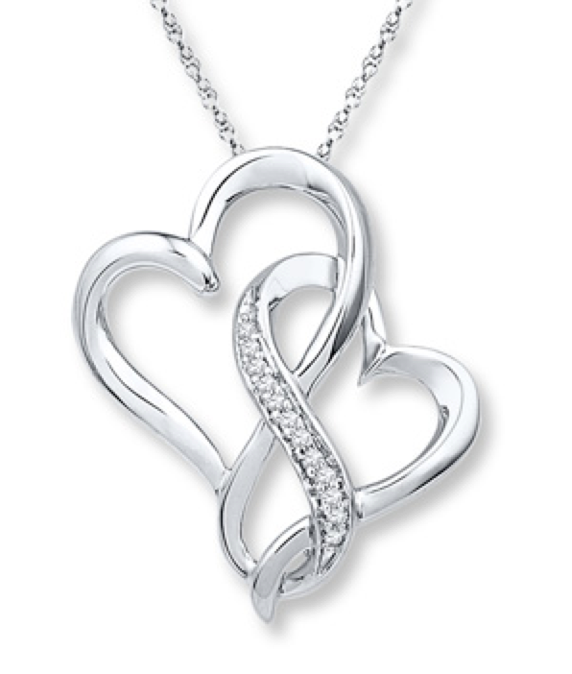
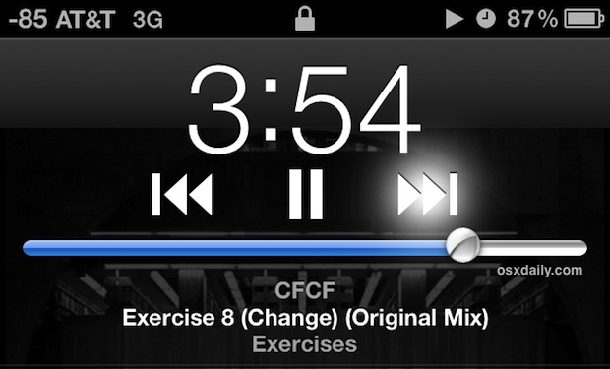


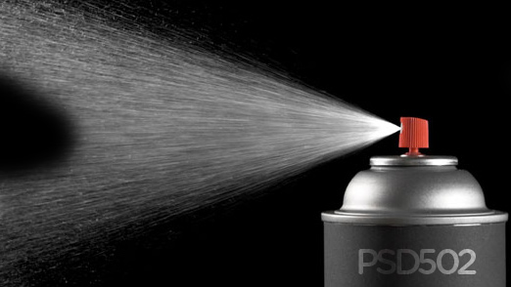
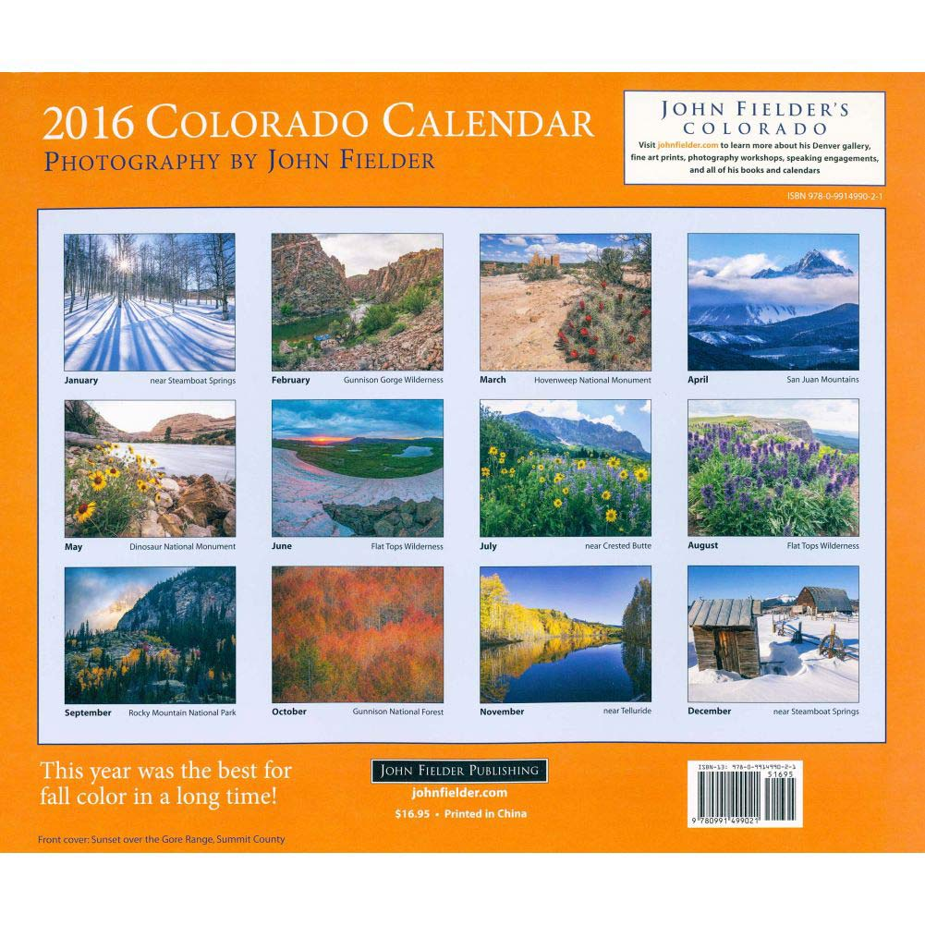
Suspicious Latent Topics
hardcover guide design handbook international health business social law science english
vhs world series time king war ball house trek christmas space dog circle
license standard symantec system service cisco support year essential years package upgrade
heart diamond pearl 40 ring sterling chain charm 39 14k 47 bracelet watch stainless pendant
i c love day e night u single lady child woman uk good deluxe park
dvd jazz media mixed country artists vol play music product pop ed import john complete club
paperback book history god home und soul stories journey bible der die code people
set 20 100 24 case kit oz 30 hand drive body wall digital ft 48 spray paper liquid mount gift
de calendar la american disc el 2013 art 2009 ray 2012 compact america great 2010

Slide 13
Latent Topic | Some latent topics labeled using noisy classifier
oxford burgundy plain espresso wing madison [sorel bungee tip cord buffalo brogue florsheim] | Oxfords > Men's_Shoes > Shoes | Conf: 36.91 Flats > Women's_Shoes > Shoes | Conf: 16.45 Sneakers_&_Athletic_Shoes > Girl's_Shoes > Kids_&_Baby_Shoes > Shoes | Conf: 13.25
pr boots work mens blk composite [brn ee wrk comp stl prwork 8inh] | Boots > Men's_Shoes > Shoes | Conf: 44.4 Sneakers_&_Athletic_Shoes > Men's_Shoes > Shoes | Conf: 39.63 Boots > Women's_Shoes > Shoes | Conf: 4.72
sneaker low top perforated marc neck [roll sapphire tank robin ruffle petite profile] | Boots > Girl's_Shoes > Kids_&_Baby_Shoes > Shoes | Conf: 43.29 Sneakers_&_Athletic_Shoes > Men's_Shoes > Shoes | Conf: 30.99 Sneakers > Women's_Shoes > Shoes | Conf: 22.25
tan polyurethane life saddle stride bed [lux brandy women rustic galaxy teak stu] | Flats > Women's_Shoes > Shoes | Conf: 29.48 Boots > Women's_Shoes > Shoes | Conf: 24.57 Other > Shoes | Conf: 6.67
13 reaction york ak driving steven [rust polished ny wallet belt key unlisted] | Sneakers_&_Athletic_Shoes > Men's_Shoes > Shoes | Conf: 53.92 Sandals > Women's_Shoes > Shoes | Conf: 26.13 Boots > Women's_Shoes > Shoes | Conf: 4.27
original rose bone mark lizard copper [company tobacco croc luggage classics] | Climbing > Men's_Shoes > Shoes | Conf: 57.21 Loafers > Men's_Shoes > Shoes | Conf: 12.47 Boots > Women's_Shoes > Shoes | Conf: 7.56
Suspect
Suspect
Notes:
Topic words in square brackets = additional words not used as input to the classifier

Slide 14
Topic modeling can be very useful in identifying
topics which are orthogonal to a “Shoes”
concept

Slide 15


Slide 16
Experiments using Deep Learning being conducted on the smaller Slice dataset by ASI,
Yandi Xia (Awesome Summer Intern)
Category: Apparel
GBT: Precision, F1 – 85.97
CNN: Precision, F1 – 86.47
Publicly available product listing dataset for academic research is being processed to validate the classification experiments
http://jmcauley.ucsd.edu/data/amazon/
9.4 million listings
29,000 leaf nodes

Slide 17


Slide 18
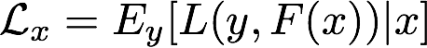
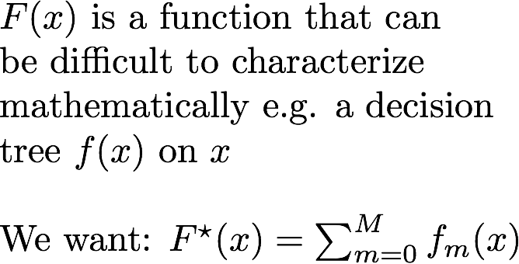
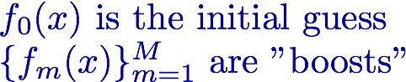
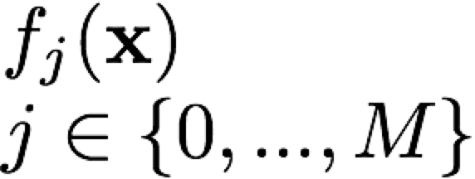
carrot:1
salmon:1
Meal contains high fiber veggies?
…
butter:3
pasta: 1
No
Yes
Meal contains bread, butter and olive oil?
Meal contains whole wheat pasta?
Yes
No
Yes
Unhealthy meal
Meal contains grilled fish?
Healthy meal
Stage-wise additive function
Yes
Healthy meal

Slide 19
carrot:1
salmon:1
Meal contains grilled fish?
…
butter:3
pasta: 1
Yes
Healthy meal
Stage-wise additive function

Slide 20
carrot:1
salmon:1
Meal contains bread, butter and olive oil?
…
butter:3
pasta: 1
Yes
No
Unhealthy meal
Meal contains grilled fish?
Yes
Stage-wise additive function
Healthy meal

Slide 21
Boosted Tree model
f₁(x)
f₂(x)
f_{M}(x)
…
w₁
w₂
D_{K}
w₁
D_{K}
w₁
w₂
D_{K}
w_{1N}
D₂₁
+
w_{1N}
+
…
+
w_{1N}
D₂₁
D₁₁
…
D₁₁
…
D₁₁
D_{1N1}
D_{1N2}
D_{1NP}
D_{1N1}
D_{1N2}
D_{1NP}
D_{1N1}
D_{1N2}
D_{1NP}
w₂
w₁
w_{M}
Combined decision for x

Slide 22

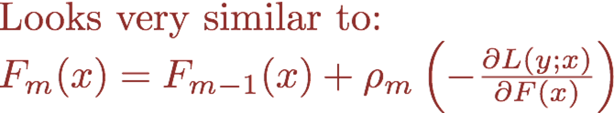
Start with some a_{m} and find the best one
Step Length
Search Direction

Slide 23
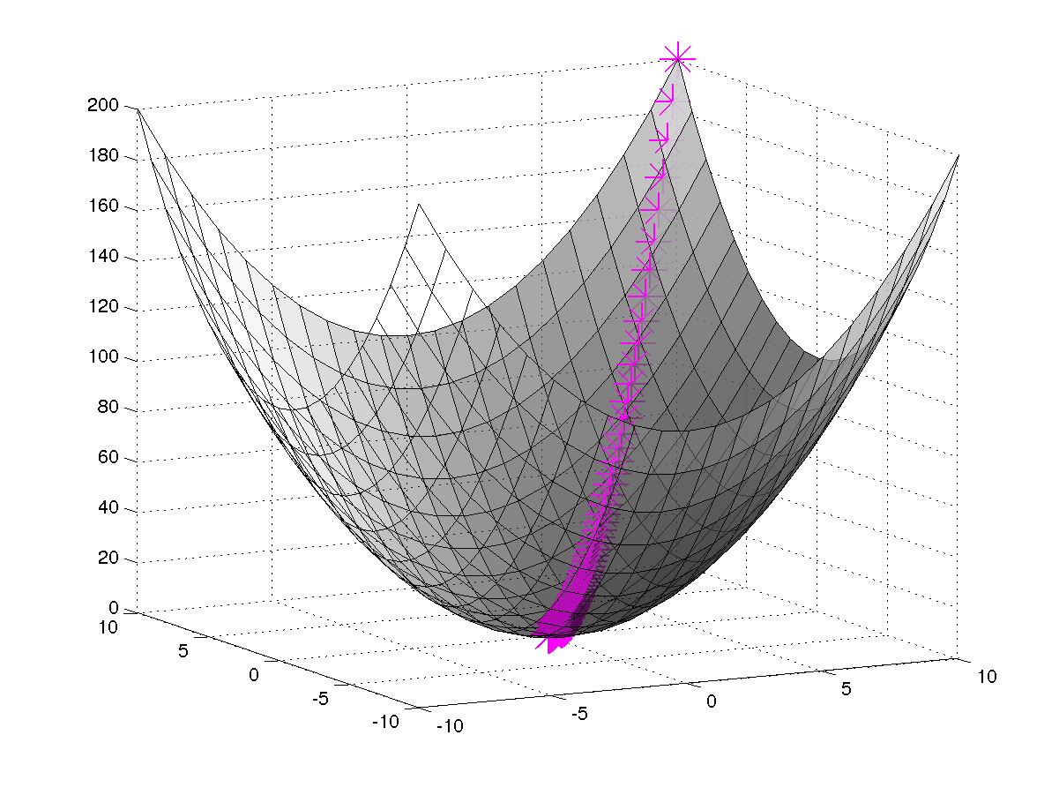


Start somewhere
This is where you need to go

Slide 24
